Slide 1


Global Weather Analysis using ES and Kibana
CIS 3200-01
Group 2
By: Andrea Garcia-Tellez, Felix Garcia, Karla Salazar, Kyle Giang
Notes:
Andrea

Slide 2





What is the World Weather Repository?
A global weather dataset from Kaggle
Daily weather data for capital cities worldwide (since August 2023)
40+ features:
Temperature
Humidity
Air quality
Precipitation
And more…
Reflects current conditions, not forecasts
Used to explore global weather patterns and climate trends
Notes:
Andrea

Slide 3



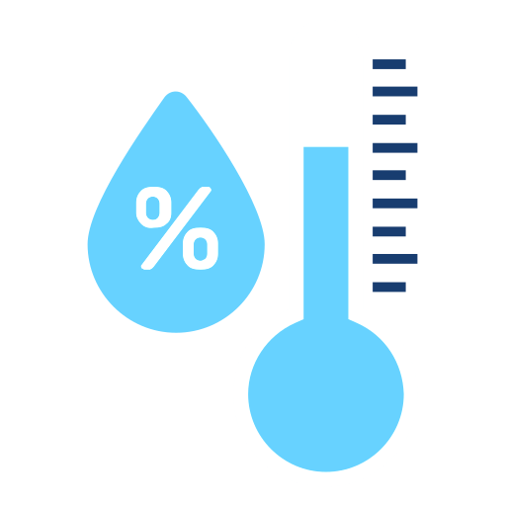



Introduction
Using the World Weather Repository dataset, we explore global weather patterns to uncover:
Regions with higher UV intensity
Areas with poorer air quality
Global distribution of weather conditions
Cities with the highest humidity
Notes:
Andrea

Slide 4
Data Source
Dataset name: Global Weather Repository (Kaggle)
Link: https://www.kaggle.com/datasets/nelgiriyewithana/global-weather-repository
Format: CSV (converted to JSON, 30 MB)
Key fields (41 total columns): Country, City, Temperature, Humidity, UV Index, Air Quality, etc.
Notes:
Felix

Slide 5
Platform Specification
Tool
Version/Details
Elasticsearch
Kibana
Git Bash
Dataset
File Format
System
OS
8.9.1
8.9.1
Latest Version
GlobalWeatherRepository (from Kaggle)
Weather_bulk.json(~30 MB)
LocalHost deployment (Windows/Mac)
Windows 10/11
Notes:
Felix

Slide 6




Architecture Chart
Git Bash
Elasticsearch
Kibana
Visualize and analyze
Index Data
Upload data files
Create Data View
Create Visualization Charts
Create Dashboards
* A similar process was used for Elastic Cloud

Slide 7

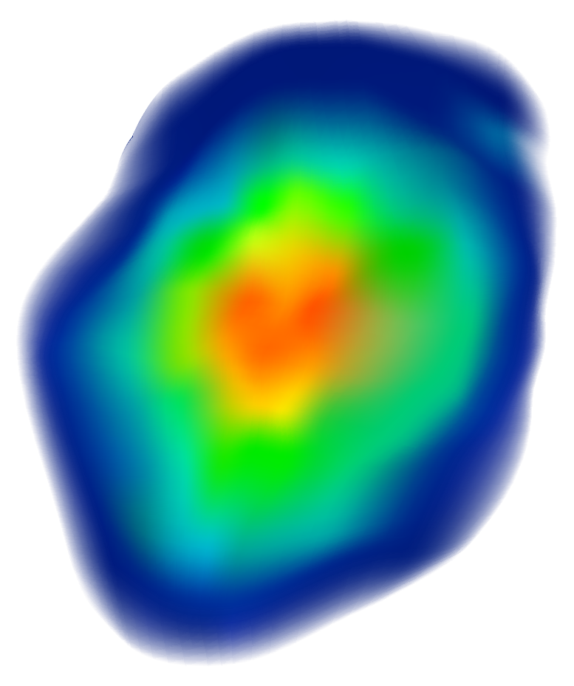
Implementation Flow Chart
Raw Dataset Acquisition (weather_bulk.json)
Index Mapping Creation
(Define schema in ES)
Data Ingestion
(Git Bash→ES)
Kibana Data Curation
(Create DV & Update)
Final Analysis & Reporting
Advanced Machine Learning
Exploratory Data Visualization
Notes:
Karla

Slide 8


Implementation of Analysis
Step 1
Download JSON weather dataset to the local machine
Step 2
Start Elasticsearch and Kibana services
Step 3
Create the weatherdata index and define field mapping
Step 4
Upload the JSON dataset using bulk API
Step 5
Create a Data View in Kibana for weatherdata index
Step 6
Verify and update the geo_point field for mapping support
Notes:
Karla

Slide 9
Implementation of Analysis cont.
Step 7
Clean and update location data as needed
Step 8
Create visualizations in Kibana
Step 9
Upload the dataset to Elastic Cloud for ML Analysis
Step 10
Create a multi-metric anomaly detection model
Step 11
Create a regression model to predict temperature values
Notes:
Karla

Slide 10








Visualizations
Information used:
Types of Visuals:
City and Country Data
Weather Conditions
Humidity Levels
UV Index
Air Pollution Severity
Pie Chart - Heat, Weather Conditions
Bar Charts - Humidity, UV Index
Map Charts - UV Intensity, Air Pollution
Tools used:
Elasticsearch - organizes and queries data
Kibana - builds visuals insights and dashboards

Slide 11
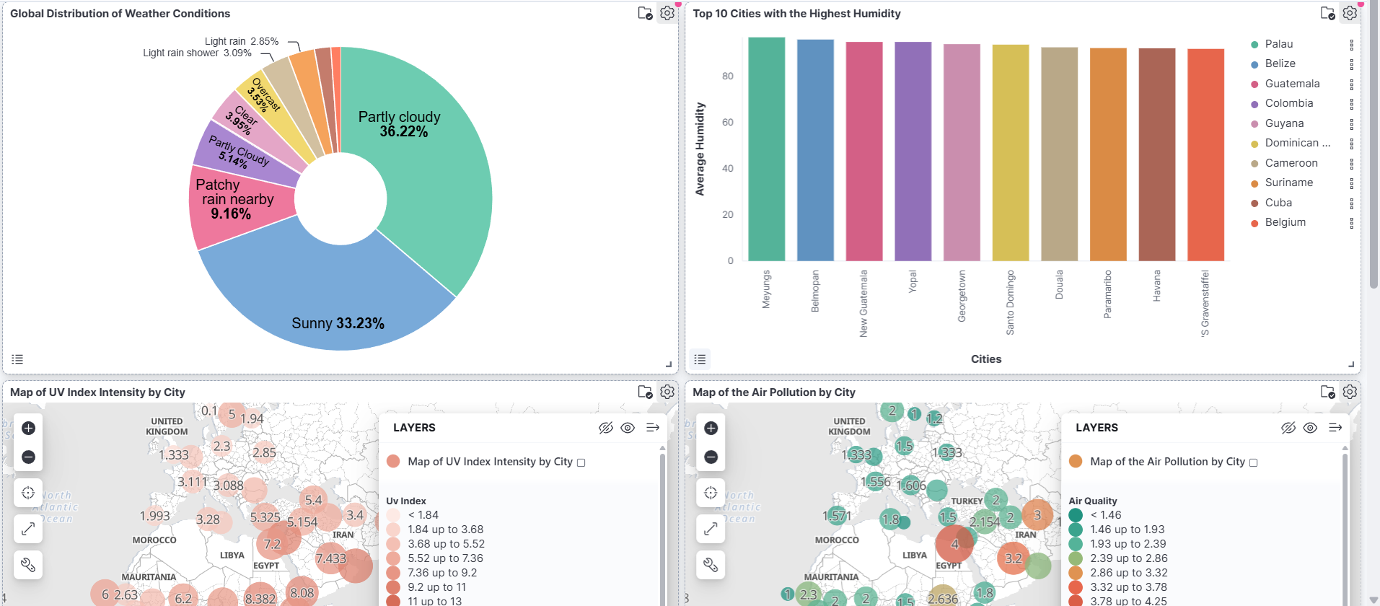
Dashboard
Preview of our Dashboard (Pie, Bar, & Map Charts):

Slide 12
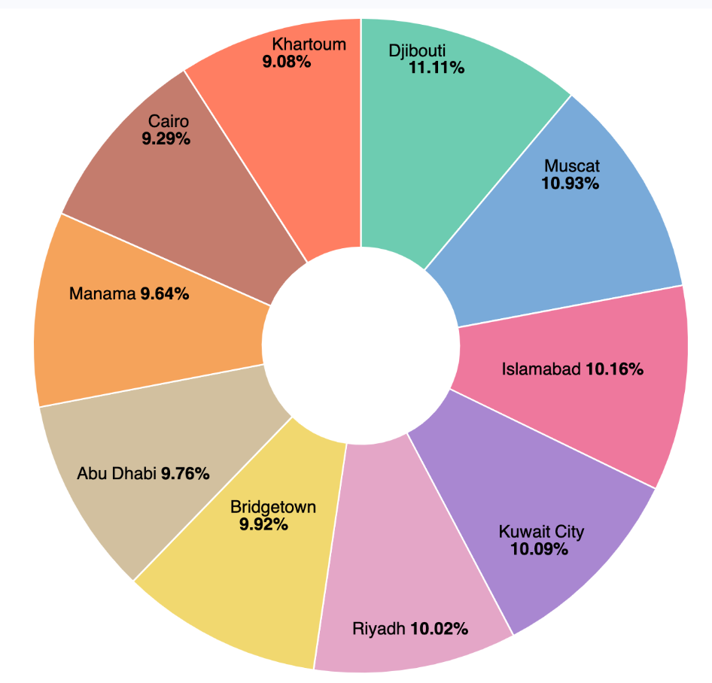
Top 10 Cities Experiencing the Most Cumulative Heat
Use Case: Identify which are the cities that tend to feel the hottest.
Summary:
Djibouti is the number one city that feels the hottest by 11.11%
Khartoum is the lowest city that feels the hottest by 9.08%
It is very concentrated in cities in Middle East and South Asia

Slide 13
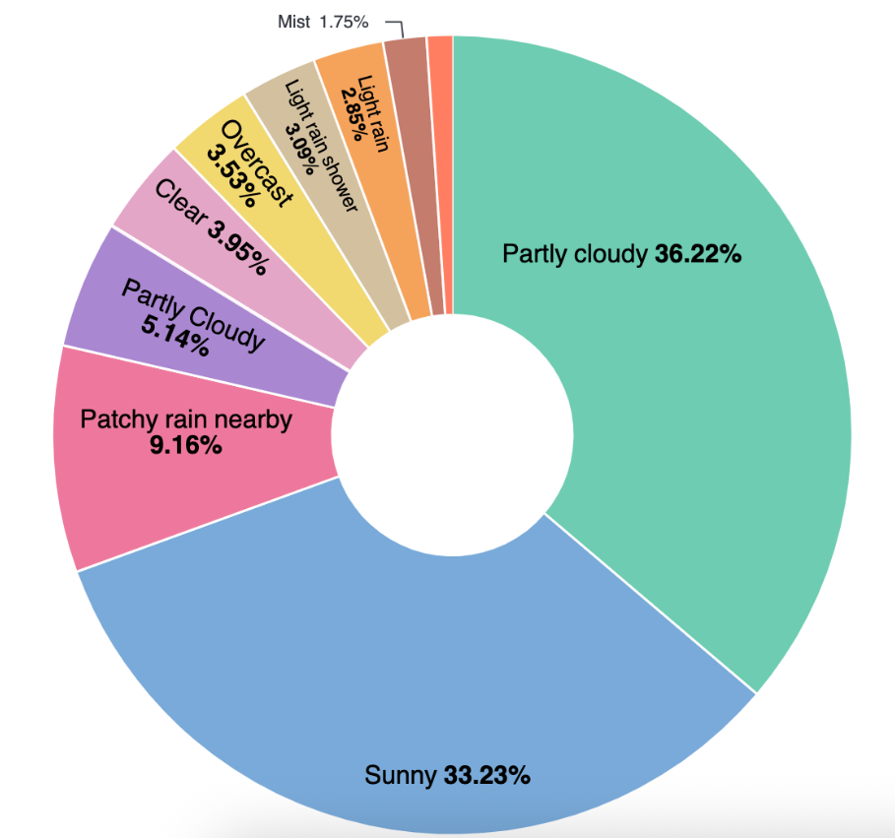
Global Distribution of Weather Conditions
Use Case: See which types of weather dominate all across the world
Summary:
Partly Cloudy is the the number one weather type that dominates all around the world with 36.22%
Sunny is second place with 33.23%
The lowest weather condition is Mist with 1.75%

Slide 14
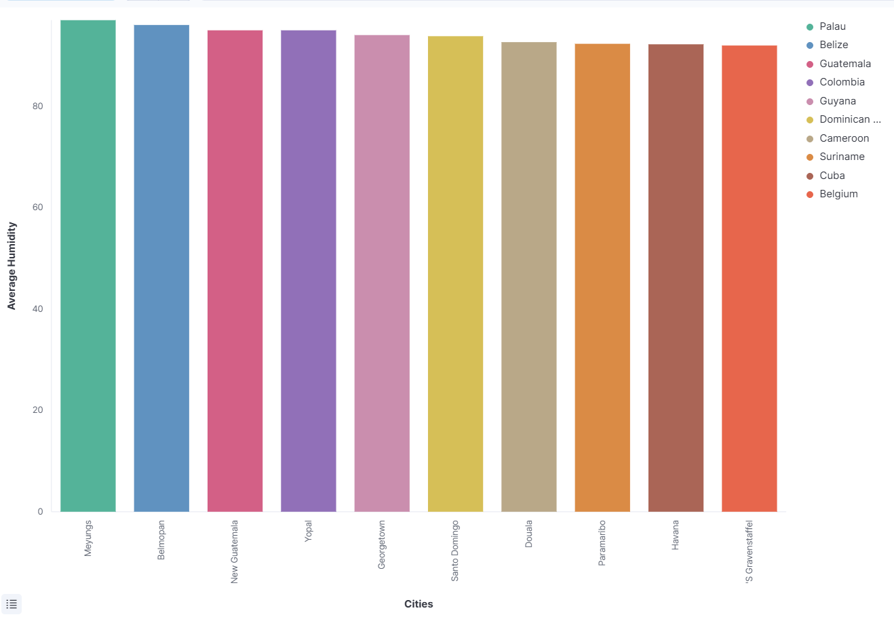
Top 10 Cities with the Highest Humidity
Use Case: Identify top 10 cities' with the highest humidity, which could help for public health, urban planning (heat island combat), and logistics.
Summary:
Most humid cities are tropical & near the equator, heavily represented by Central/South America and the Caribbean.
Average humidity levels are extremely high (clustering just under 90%).
This data is a key indicator for identifying heat-related public health risks (heat stress).

Slide 15
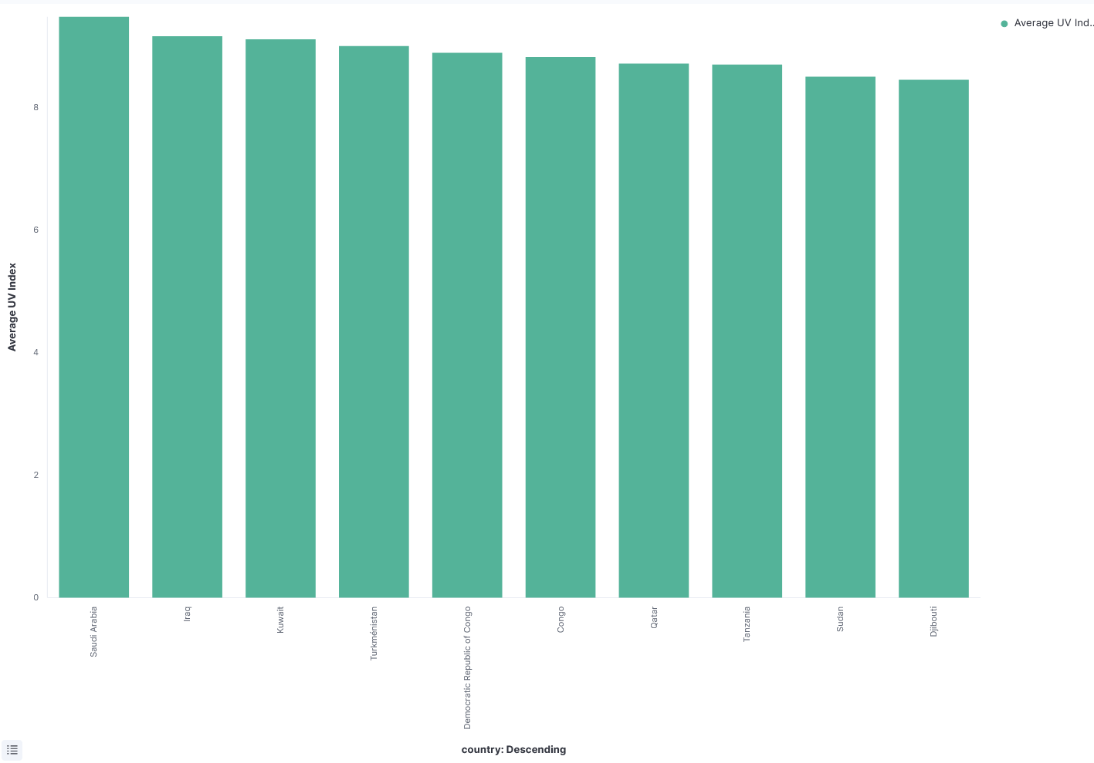
Top 10 Countries with the Highest Average UV Index
Use Case: Identifies regions with extreme average UV exposure to guide public health campaigns, inform sunscreen recommendations, & predict risks for solar power infrastructure degradation.
Summary:
High average UV index (7+) is concentrated in the Middle East & Central Africa, linked to equator proximity, high altitude, & clear skies.
Since UV Index 6+ is considered 'high' & requires immediate skin protection, governments in these regions must prioritize skin cancer & education initiatives.

Slide 16
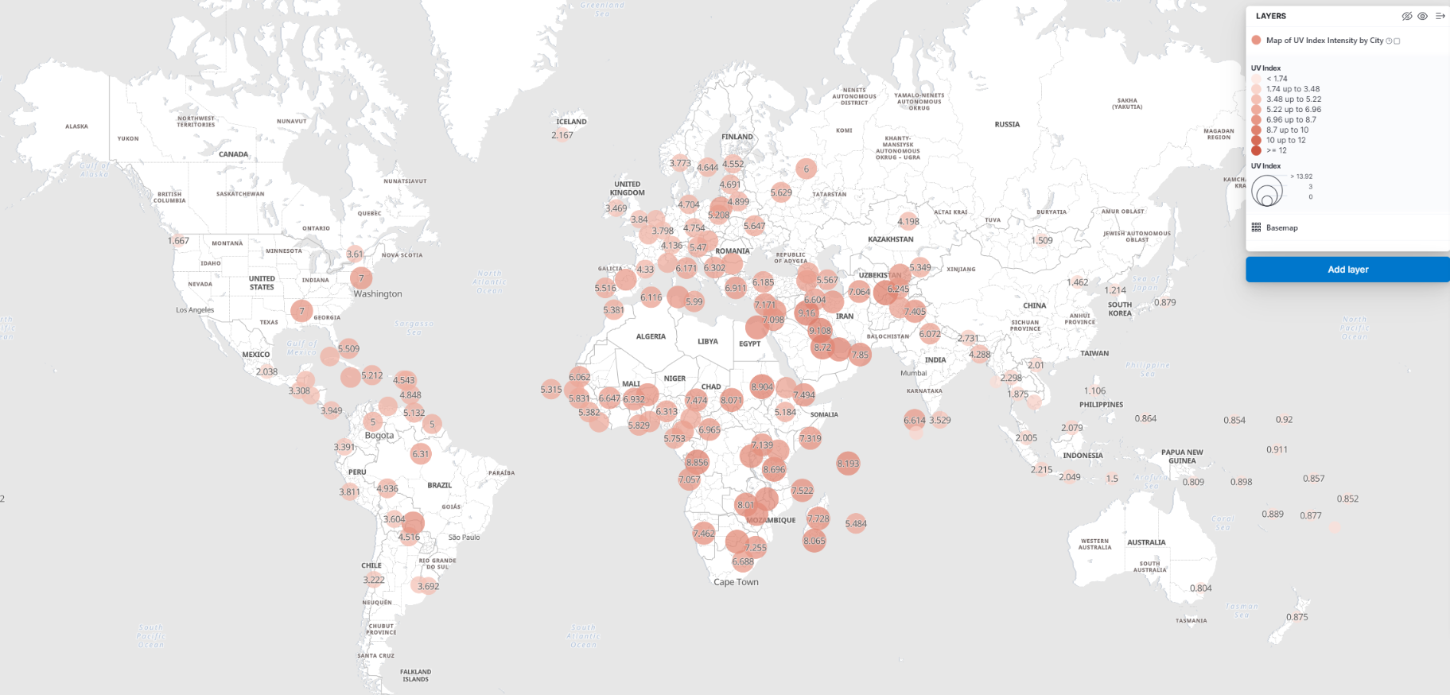
Map of UV Index Intensity by City
Use Case: Identify which region are exposed to the strongest UV radiation
Metrics:
Aggregation: average UV Index
Field: uv_index

Slide 17
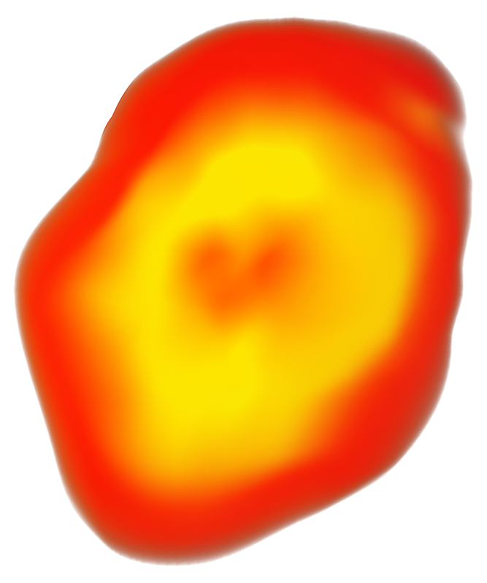
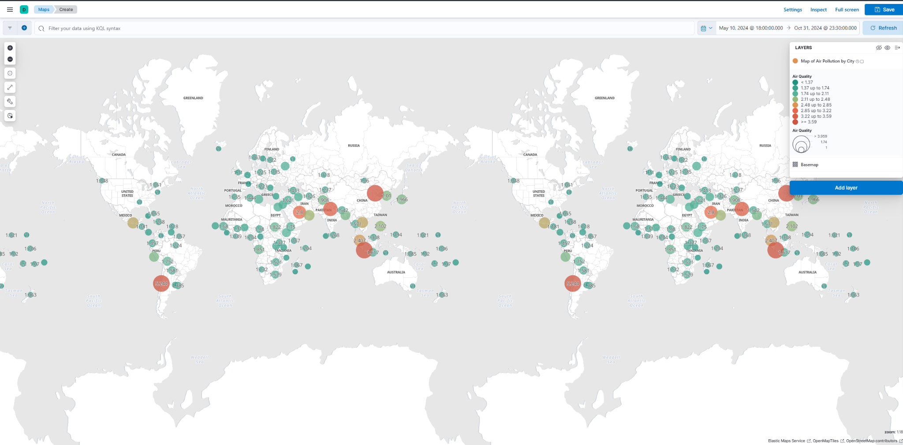

Map of Air Pollution by City
Use Case: Highlights where air quality is better or worse
Metrics:
Aggregation: average air quality
Field: air_quality_us-epa-index
*standardized overall air quality index from the US EPA

Slide 18
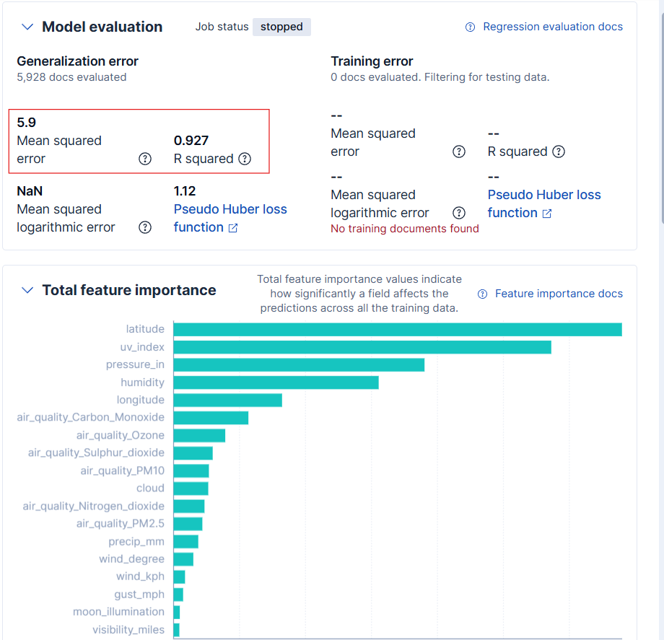
ML Algorithm: Regression
Summary:
Goal: Predict temperature_celsius using a comprehensive set of real-world weather data.
Removed redundant & data-leaking variables
5.9 Mean Squared Error: means the predictions are off by 2.43℃.
0.927 R-squared: means the selected features explain 92.7% of the variability.
Notes:
The Total feature importance chart shows what the model relied on to achieve that 92.7% accuracy:
The most influential features are:
latitude
uv_index
pressure_in
humidity
longitude

Slide 19
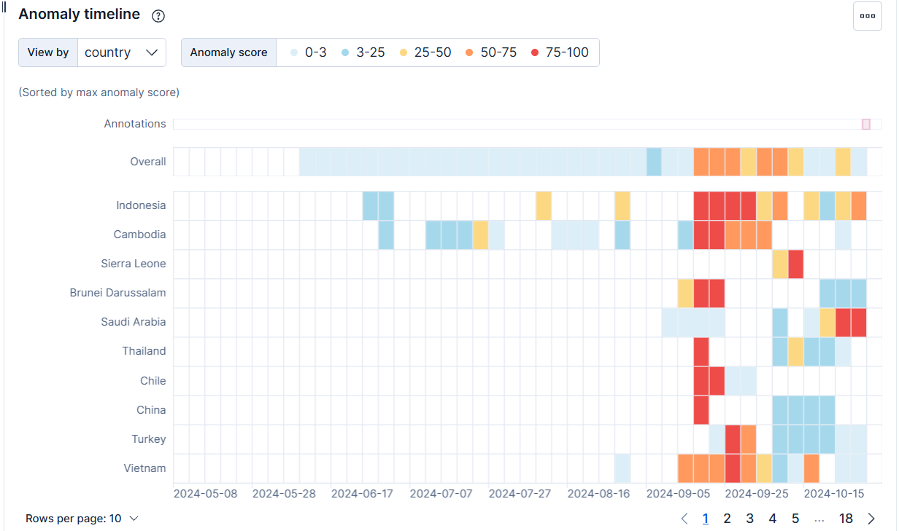
ML Algorithm: Multi-metric
Summary:
Goal: Identify outlier cities & unusual daily weather patterns by monitoring the mean of four key metrics: temperature, humidity, UV index, & air quality.
Key Findings: It detected extreme anomalies (scores up to 99), identifying daily city metrics far outside their historical typical range.
Top Influencers: Fields that were most frequently associated with the detected anomalies are:
1) country 2) humidity 3) uv_index
Notes:
The most extreme anomaly found was the UV index in Freetown, Sierra Leone, measured as 22x lower than its typical value for that time.
Air quality in Sucre, Bolivia, was flagged for being up to 9x higher than its typical reading.
Temperature in cities like Riyadh, Saudi Arabia, and Khartoum, Sudan, was detected as being up to 2x lower than their expected values.

Slide 20
Conclusion
Air quality mostly good; poorer in China, Chile, Pakistan, Saudi Arabia, & Indonesia
UV highest in Saudi Arabia and Africa which reflects their dry & sunny regions
Partly Cloudy, Sunny, Patchy Rain, and clear conditions are most frequent with severe weather being less common.
The cities that tend to experience the most cumulative heat are heavily concentrated in the Middle East and South Asia (ex: Muscat & Pakistan)
Overall, the use of ElasticSearch and Kibana successfully creates a dynamic, geographic dashboard for transforming raw weather data into actionable insights, enabling effective, real-time risk assessments of global climate vulnerabilities.

Slide 21

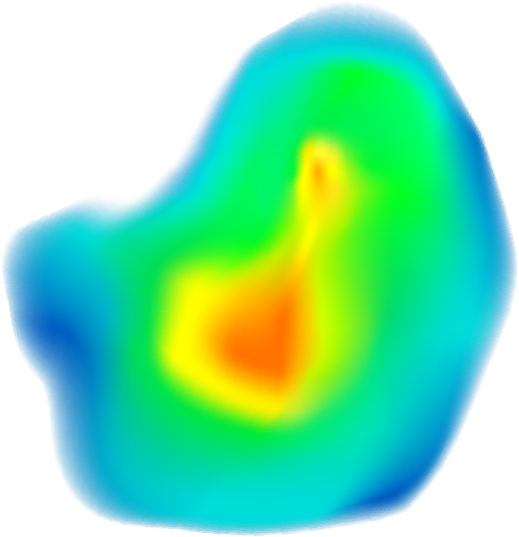



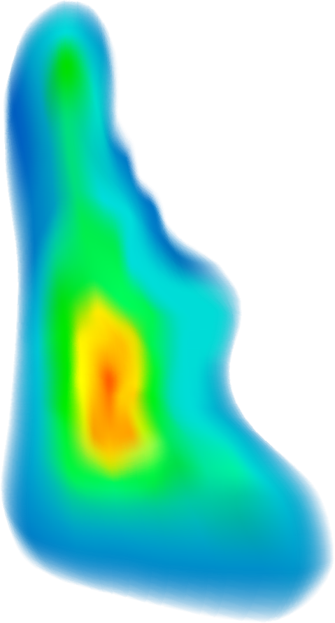
GitHub Link
Link:
https://github.com/ksalaz63/GlobalWeatherAnalysis
Downloadable dataset
Tutorial
Presentation
Report

